Slide 1
Incorporating Embedding Feature for Speech Enhancement
Ryandhimas Zezario
Notes:
1

Slide 2
What is Embedding?
Embedding Feature is basically the output of hidden layer.
Where the goal of embedding features or hidden representations is to teach the algorithm to do it’s own feature engineering.
Therefore, by training a model in specific task, useful context of hidden layer representation can be generated.

Slide 3
What is Embedding?
For example, a model is trained to recognition speaker ID. Thus, information related to speaker ID may be obtained during extracting hidden layer.
In [1], the embedding feature of speaker ID is extracted and injected to robust the performances of speech enhancement.
[1] F.-K. Chuang, S.-S. Wang, J.-w. Hung, Y. Tsao, and S.-H. Fang, "Speaker-aware Deep Denoising Autoencoder with Embedded Speaker Identity for Speech Enhancement," Interspeech 2019, September 2019.

Slide 4
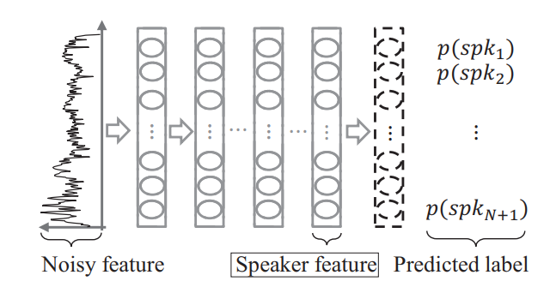
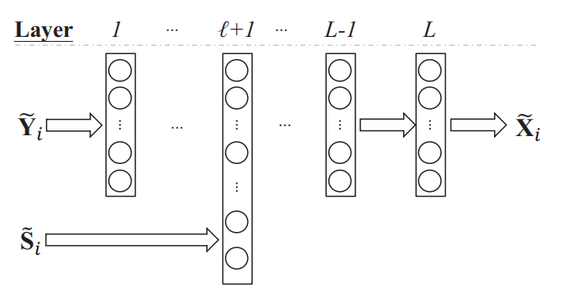
What is Embedding?
[1]
[1] F.-K. Chuang, S.-S. Wang, J.-w. Hung, Y. Tsao, and S.-H. Fang, "Speaker-aware Deep Denoising Autoencoder with Embedded Speaker Identity for Speech Enhancement," Interspeech 2019, September 2019.

Slide 5
Proposed Method
In our work, we aim to introduce few shot learning by taking the advantages of embedding features.
In detail, we will extract hidden layer representations of Quality-Net, considering in some of particular dataset noise information may not be always available.
Moreover, a clean reference is mostly available and thus it allows us to train Quality-Net.

Slide 6






Proposed Method
Quality-Net
Output Layer
Hidden Layer
Forward layer
Backward layer
Feedforward
Layer
Frame-Wise
Score
Estimated Evaluation Metric Score
Noisy
Feature
Extraction
$$h_{1}$$
$$q_{1}$$
Global
Average
Enhanced
$$h_{t}$$
PESQ
$$q_{t}$$
Clean
$$h_{T(u)}$$
$$q_{T(u)}$$
Embedding Feature
Quality
Feature

Slide 7
Proposed Method
Extracting Quality Embedding
Clustering
Speech Enhancement
Training
Noisy
Feature
Extraction
Quality
Net
Clean Label
Cluster n
Noisy
Speech Enhancement
Training
SE n Model
Embedding Feature
Quality
Embedding
KMEANS
…
…
…
Cluster N
Noisy
Speech Enhancement
Training
SE N Model
Clean Label

Slide 8
Results
Car | Noisy |  | CNN |  | Few-Shot (EQ)
 | PESQ | STOI | PESQ | STOI | PESQ | STOI
SNR 15 | 3.36 | 0.97 | 3.25 | 0.91 | 3.33 | 0.92
SNR 10 | 2.93 | 0.93 | 3.12 | 0.90 | 3.17 | 0.91
SNR 5 | 2.51 | 0.88 | 2.92 | 0.88 | 2.94 | 0.89
SNR 0 | 2.12 | 0.82 | 2.61 | 0.86 | 2.66 | 0.86
SNR -5 | 1.79 | 0.75 | 2.27 | 0.82 | 2.36 | 0.83
SNR -10 | 1.56 | 0.69 | 1.95 | 0.77 | 2.04 | 0.78
ave | 2.38 | 0.84 | 2.69 | 0.86 | 2.75 | 0.86
White | Noisy |  | CNN |  | Few-Shot (EQ)
 | PESQ | STOI | PESQ | STOI | PESQ | STOI
SNR 15 | 3.55 | 0.97 | 3.31 | 0.91 | 3.40 | 0.92
SNR 10 | 3.13 | 0.94 | 3.22 | 0.90 | 3.29 | 0.91
SNR 5 | 2.72 | 0.89 | 3.06 | 0.89 | 3.11 | 0.89
SNR 0 | 2.34 | 0.84 | 2.84 | 0.87 | 2.88 | 0.87
SNR -5 | 1.97 | 0.80 | 2.60 | 0.85 | 2.66 | 0.85
SNR -10 | 1.64 | 0.76 | 2.37 | 0.82 | 2.47 | 0.83
ave | 2.56 | 0.87 | 2.90 | 0.87 | 2.97 | 0.88

Slide 9
Results
Street | Noisy |  | CNN |  | Few-Shot (EQ)
 | PESQ | STOI | PESQ | STOI | PESQ | STOI
SNR 15 | 2.92 | 0.97 | 3.15 | 0.91 | 3.16 | 0.92
SNR 10 | 2.48 | 0.93 | 2.98 | 0.90 | 2.99 | 0.90
SNR 5 | 2.09 | 0.86 | 2.71 | 0.88 | 2.75 | 0.88
SNR 0 | 1.78 | 0.77 | 2.31 | 0.84 | 2.40 | 0.84
SNR -5 | 1.55 | 0.66 | 1.88 | 0.76 | 1.97 | 0.77
SNR -10 | 1.46 | 0.56 | 1.56 | 0.65 | 1.60 | 0.66
ave | 2.05 | 0.79 | 2.43 | 0.82 | 2.48 | 0.83
Engine | Noisy |  | CNN |  | Few-Shot (EQ)
 | PESQ | STOI | PESQ | STOI | PESQ | STOI
SNR 15 | 2.61 | 0.95 | 2.99 | 0.91 | 2.99 | 0.91
SNR 10 | 2.17 | 0.90 | 2.76 | 0.89 | 2.77 | 0.89
SNR 5 | 1.82 | 0.82 | 2.47 | 0.86 | 2.50 | 0.87
SNR 0 | 1.57 | 0.71 | 2.12 | 0.81 | 2.16 | 0.82
SNR -5 | 1.42 | 0.58 | 1.74 | 0.72 | 1.78 | 0.73
SNR -10 | 1.34 | 0.46 | 1.43 | 0.57 | 1.45 | 0.60
ave | 1.82 | 0.74 | 2.25 | 0.79 | 2.28 | 0.80

Slide 10
Conclusion
Embedding Feature has shown notable performance to perform Few-shot learning mechanism, where Quality-Net has shown an ability to extract notable feature representation.
Experimental results indicate comparable and even better performance compare to baseline system in both of seen and unseen stationary and non-stationary noise environments in term of PESQ and STOI objective evaluation metrics.

Slide 11
Thank You

